Slide 1

Chapter 8
Address
Resolution
Protocol
(ARP)
Copyright © The McGraw-Hill Companies, Inc. Permission required for reproduction or display.

Slide 2
OBJECTIVES:
To make a distinction between logical address (IP address) and physical address (MAC address).
To describe how the mapping of a logical address to a physical address can be static or dynamic.
To show how the address resolution protocol (ARP) is used to dynamically map a logical address to a physical address.
To show that the proxy ARP can be used to create a subnetting effect.
To discuss ATMARP, which maps the IP addresses when the underlying network is an ATM WAN.
To show that an ARP software package can be made of five components.
To show the pseudocode for each module used in the ARP software package.

Slide 3
Chapter
Outline
8.1 Address Mapping
8.2 The ARP Protocol
8.3 ATM ARP
8.4 ARP Package

Slide 4
8-1 ADDRESS MAPPING
The delivery of a packet to a host or a router requires two levels of addressing: logical and physical. We need to be able to map a logical address to its corresponding physical address and vice versa. These can be done using either static or
dynamic mapping.

Slide 5
Topics Discussed in the Section
Static Mapping
Dynamic Mapping

Slide 6
8-2 ADDRESS MAPPING
Anytime a host or a router has an IP datagram to send to another host or router, it has the logical (IP) address of the receiver. But the IP datagram must be encapsulated in a frame to be able to pass through the physical network. This means that the sender needs the physical address of the receiver. A mapping corresponds a logical address to a physical address. ARP accepts a logical address from the IP protocol, maps the address to the corresponding physical address and pass it to the data link layer.

Slide 7
Topics Discussed in the Section
Packet Format
Encapsulation
Operation
Proxy ARP

Slide 8
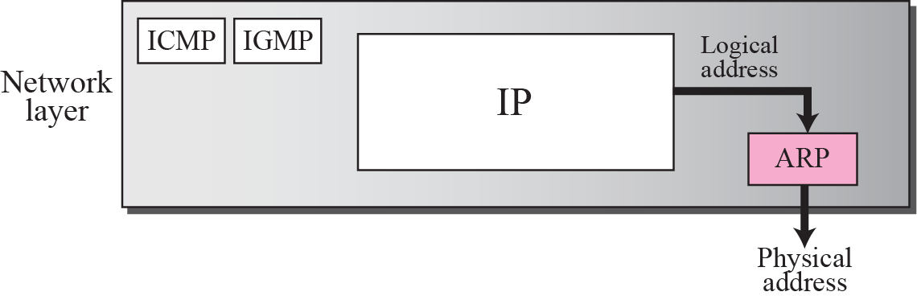
Figure 8.1 Position of ARP in TCP/IP protocol suite

Slide 9
ARP工作流程
发送节点已知接收节点逻辑地址
发送节点广播ARP查询分组
  发送节点逻辑地址、物理地址
  接收节点逻辑地址
  查询接收节点物理地址
接收节点(单播)返回ARP响应分组

Slide 10
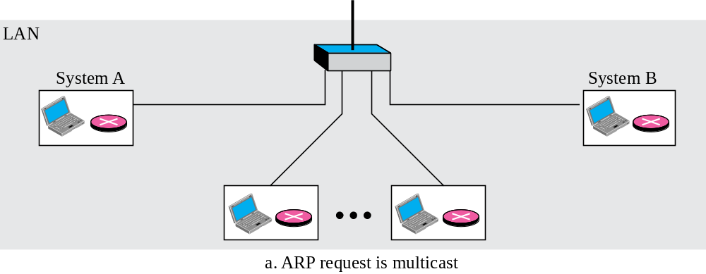
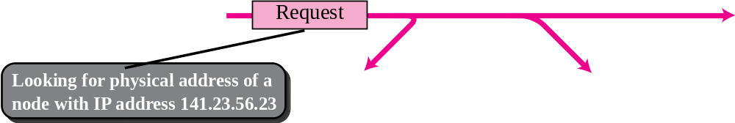
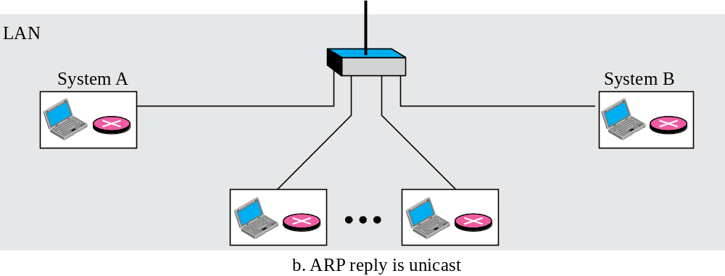
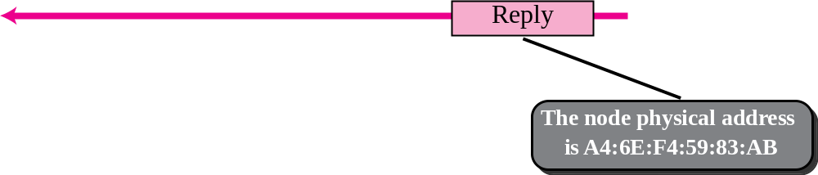
Figure 8.2 ARP operation

Slide 11
ARP分组格式
硬件类型：网络类型
协议类型：网络层协议类型
硬件长度：物理地址长度
操作：ARP分组类型
发送节点硬件(物理)地址
发送节点协议(逻辑)地址
目的节点硬件(物理)地址
目的节点协议(逻辑)地址

Slide 12
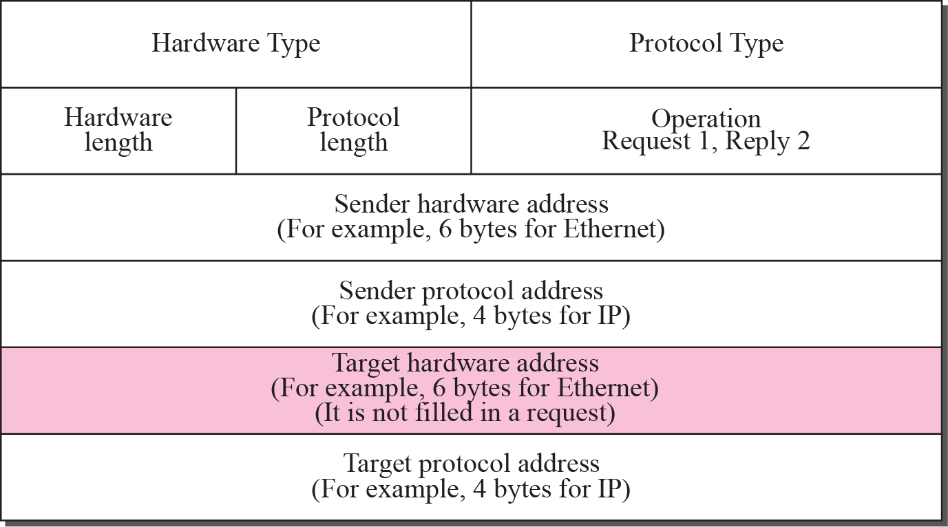
Figure 8.3 ARP packet

Slide 13
封装
ARP分组直接封装在数据链路帧中

Slide 14
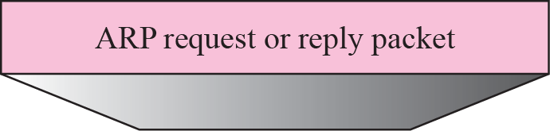
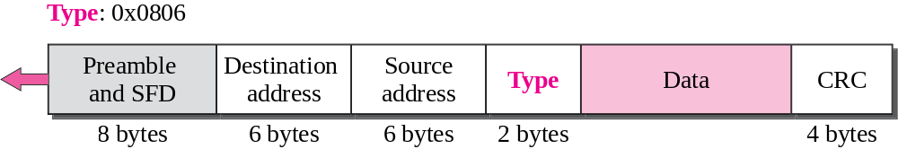
Figure 8.4 Encapsulation of ARP packet

Slide 15

Note
An ARP request is broadcast;
an ARP reply is unicast.

Slide 16
ARP操作细节(7个步骤)
P190

Slide 17
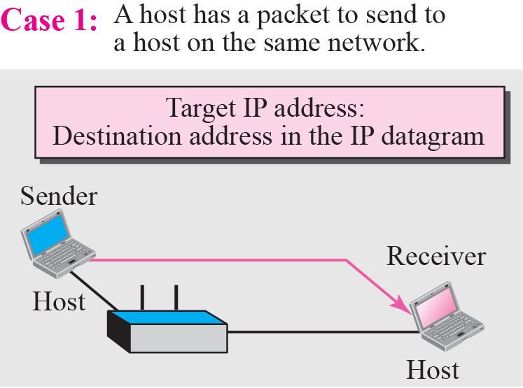
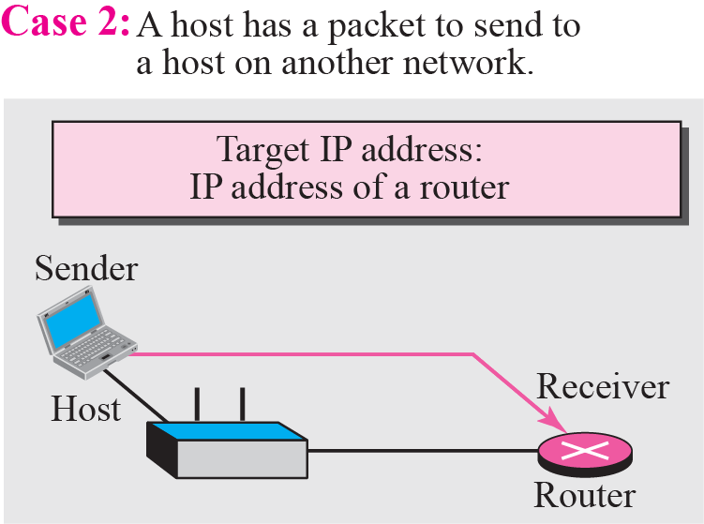
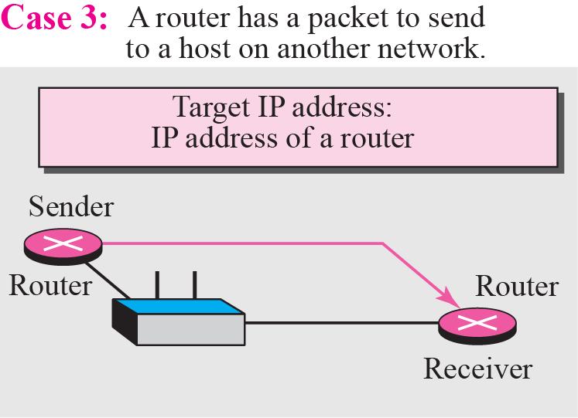
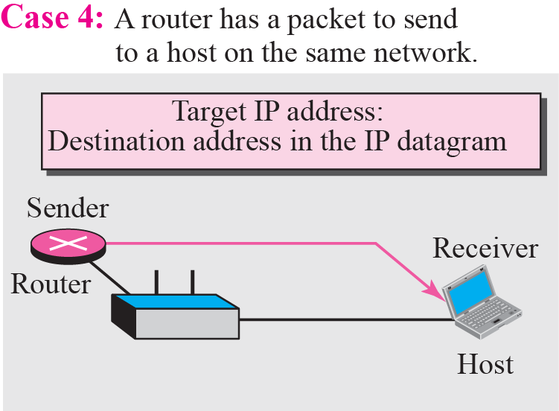
Figure 8.5 Four cases using ARP

Slide 18
Example 8.1
A host with IP address 130.23.43.20 and physical address B2:34:55:10:22:10 has a packet to send to another host with IP address 130.23.43.25 and physical address A4:6E:F4:59:83:AB. The two hosts are on the same Ethernet network. Show the ARP request and reply packets encapsulated in Ethernet frames.
Solution
Figure 8.6 shows the ARP request and reply packets. Note that the ARP data field in this case is 28 bytes, and that the individual addresses do not fit in the 4-byte boundary. That is why we do not show the regular 4-byte boundaries for these addresses. Also note that the IP addresses are shown in hexadecimal.

Slide 19
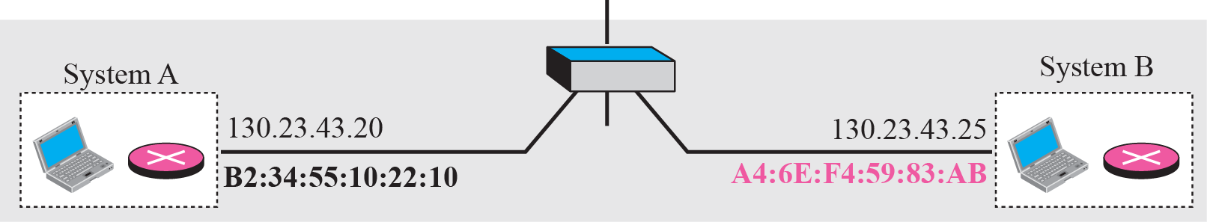
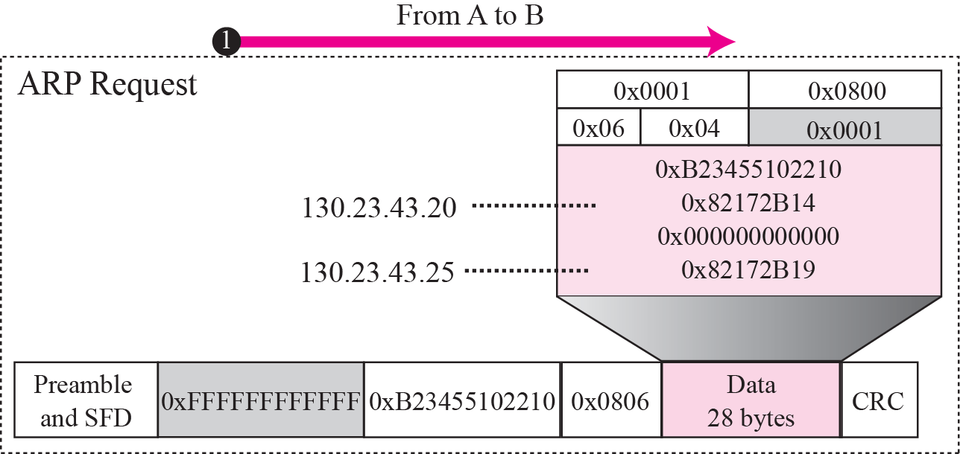
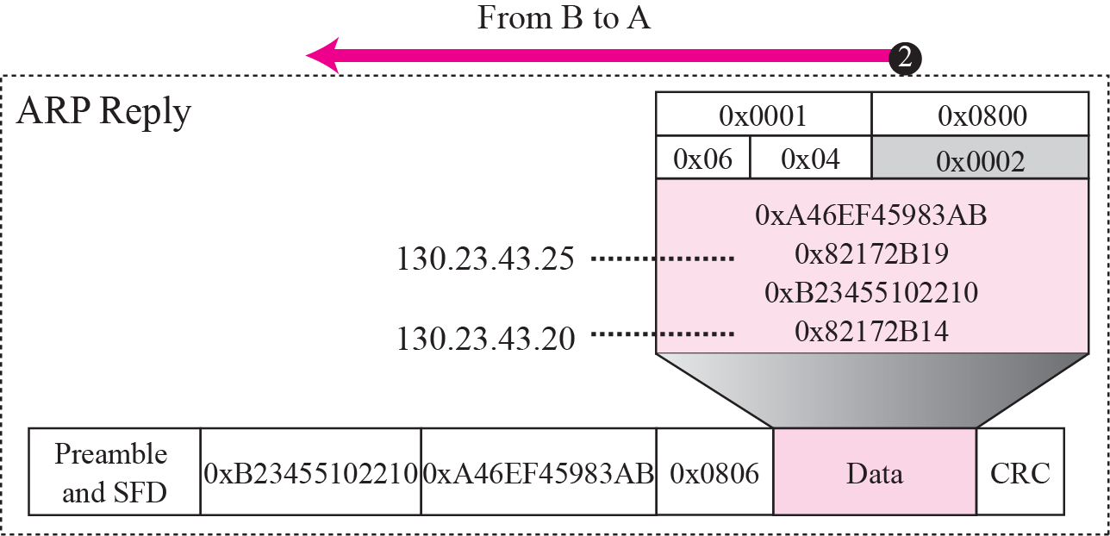
Figure 8.6 Example 8.1

Slide 20
代理ARP
产生子网划分效果
“代理ARP”代表一组主机(子网)的ARP
外网节点查询子网内节点物理地址，返回“代理ARP”路由器的物理地址；代理路由器收到IP分组后，再将IP分组转发给子网内相应的网络节点

Slide 21
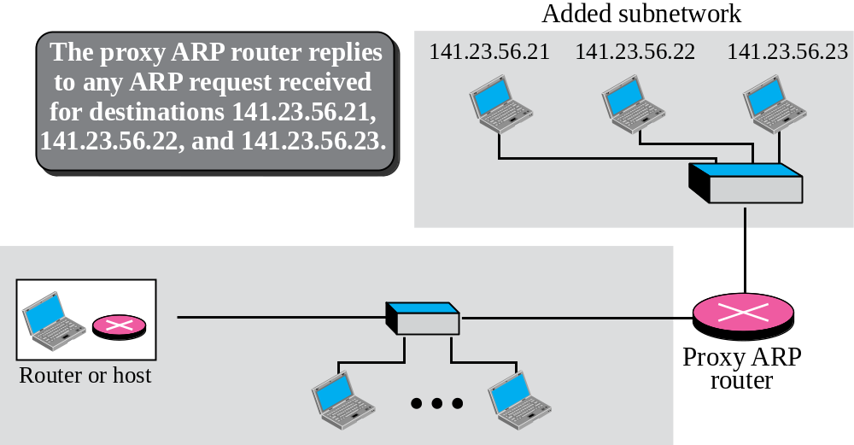
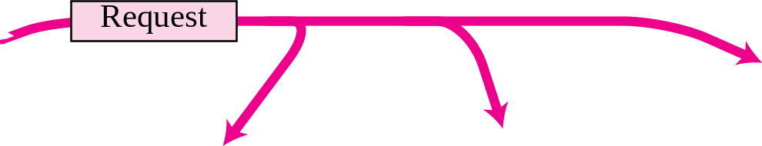
Figure 8.7 Proxy ARP

Slide 22
8-3 ATM ARP
We discussed IP over ATM in Chapter 7. When IP packet are moving through an ATMWAN, a mechanism protocol is needed to find (map) the physical address of the exiting-point router in the ATM WAN given the IP address of the router. This is the same task performed by ARP on a LAN. However, there is a difference between a LAN and an ATM network. A LAN is a broadcast network (at the data link layer); ARP uses the broadcasting capability of a LAN to send (broadcast) an ARP request.

Slide 23
Topics Discussed in the Section
Packet Format
ATMARP Operation
Logical IP Subnet (LIS)

Slide 24
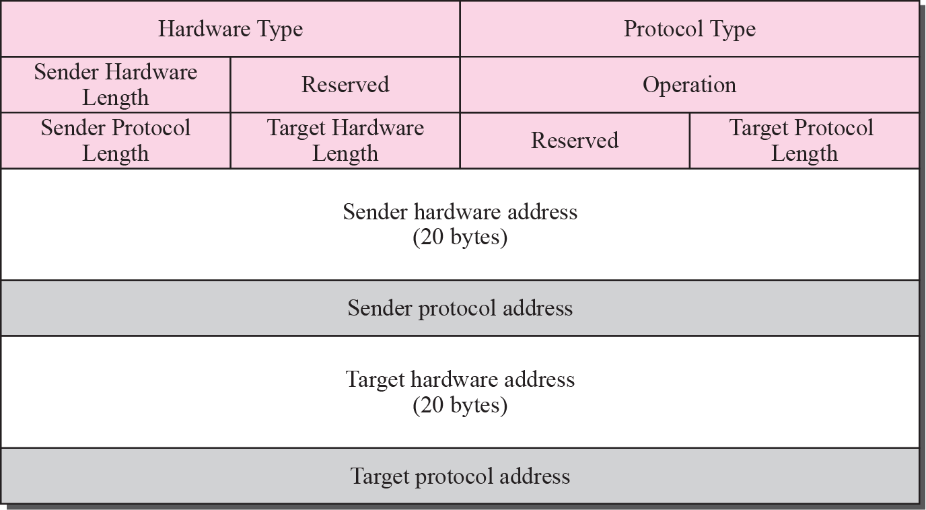
Figure 8.8 ATMARP packet

Slide 25
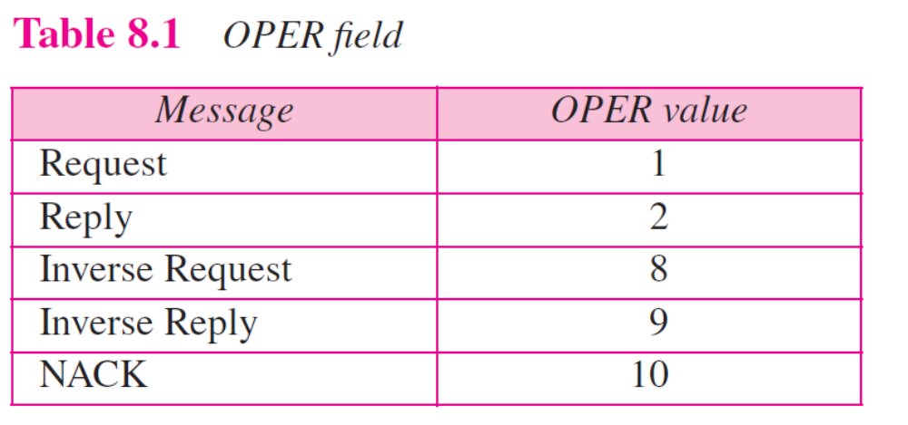

Slide 26
Note
The inverse request and inverse
reply messages can bind the
physical address to an IP
address in a PVC situation.

Slide 27
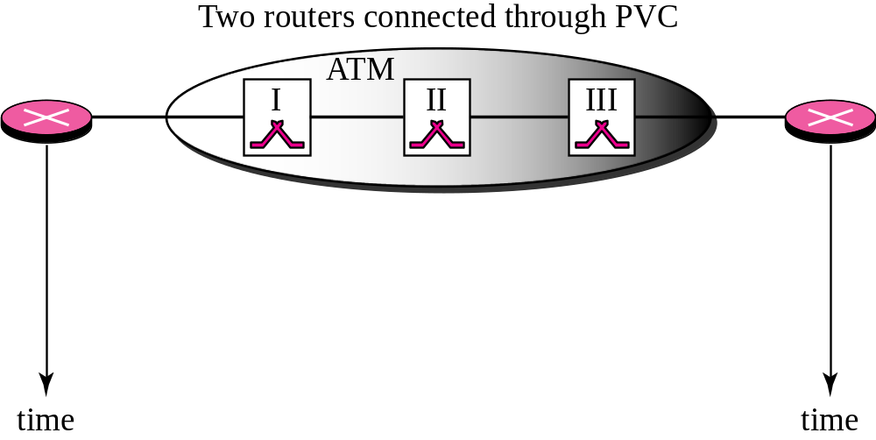
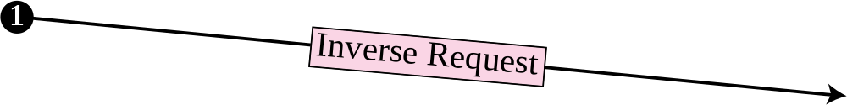
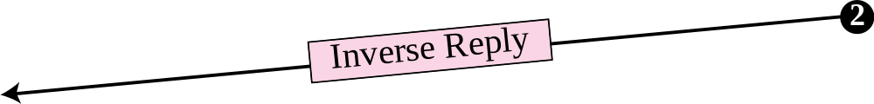
Figure 8.9 Binding with PVC

Slide 28
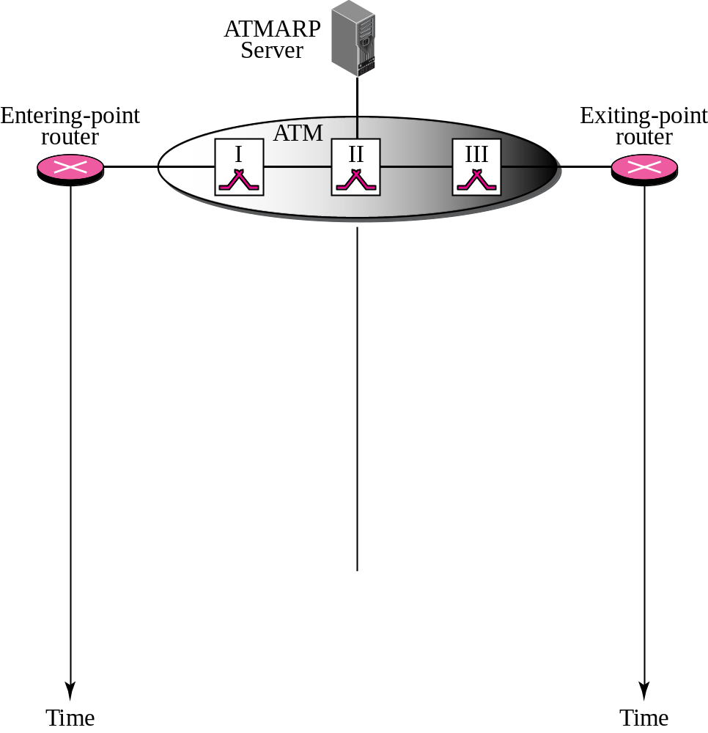



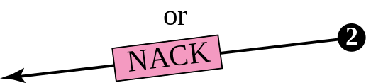

Figure 8.10 Binding with ATMARP
Finding physical
address

Slide 29
Note
The request and reply message can be used to bind a physical address to an
IP address in an SVC situation.

Slide 30
Note
The inverse request and inverse reply can also be used to build the
server’s mapping table.

Slide 31
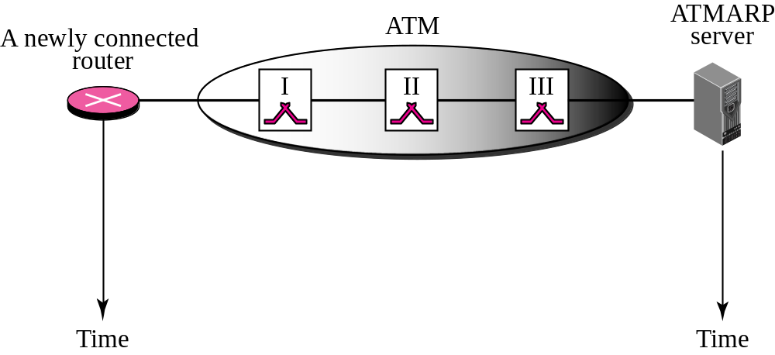
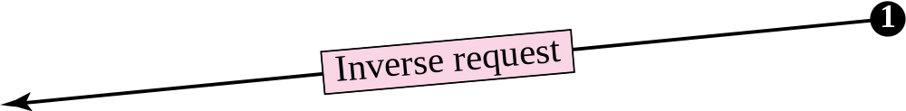
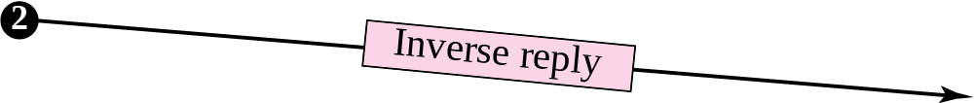
Figure 8.11 Building a table

Slide 32
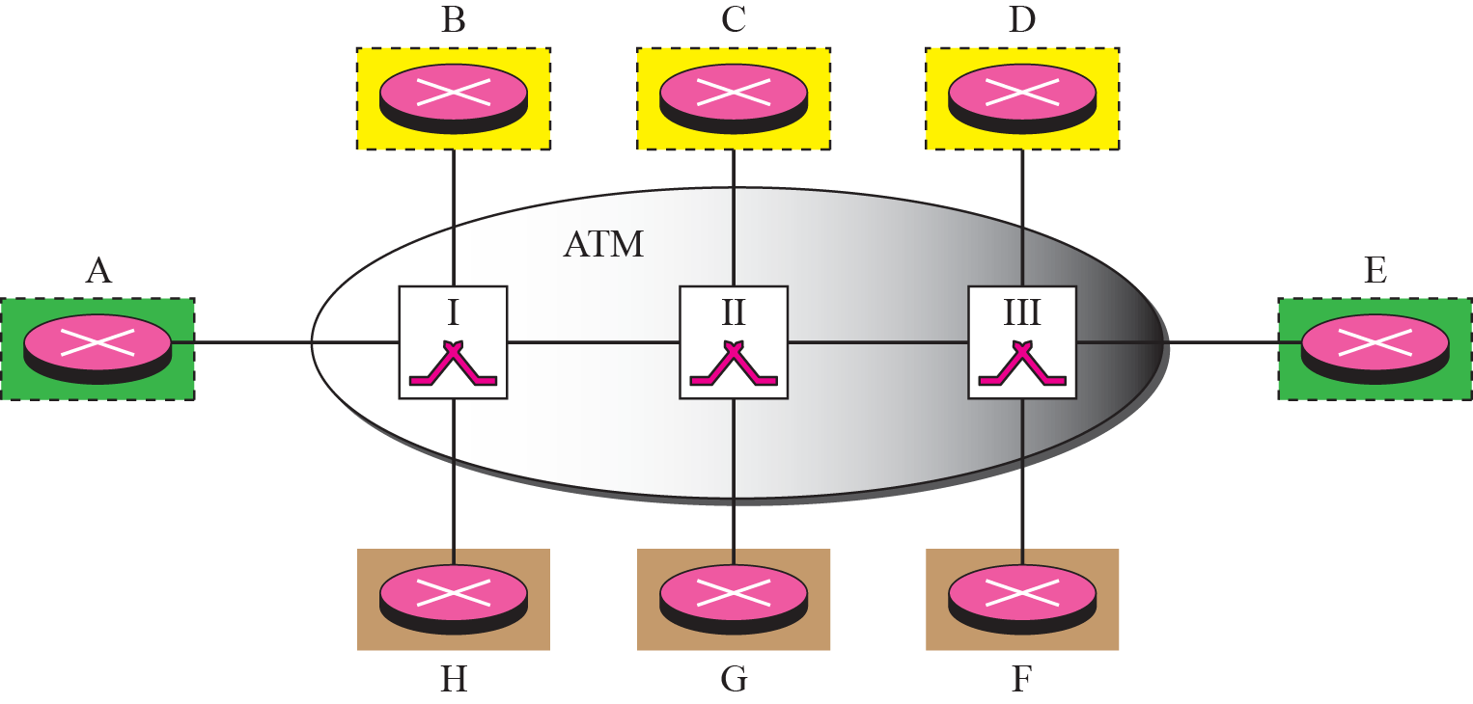
Figure 8.12 LIS

Slide 33
Note
LIS allows an ATM network to be divided into several logical subnets.
To use ATMARP, we need a separate server for each subnet.

Slide 34
8-4 ARP PACKAGE
In this section, we give an example of a simplified ARP software package. The purpose is to show the components of a hypothetical ARP package and the relationships between the components. Figure 8.13 shows these components and their interactions. We can say that this ARP package involves five components: a cache table, queues, an output module, an input module, and a cache-control module.

Slide 35
Topics Discussed in the Section
Cache Table
Queues
Output Module
Input Module
Cache-Control Module

Slide 36
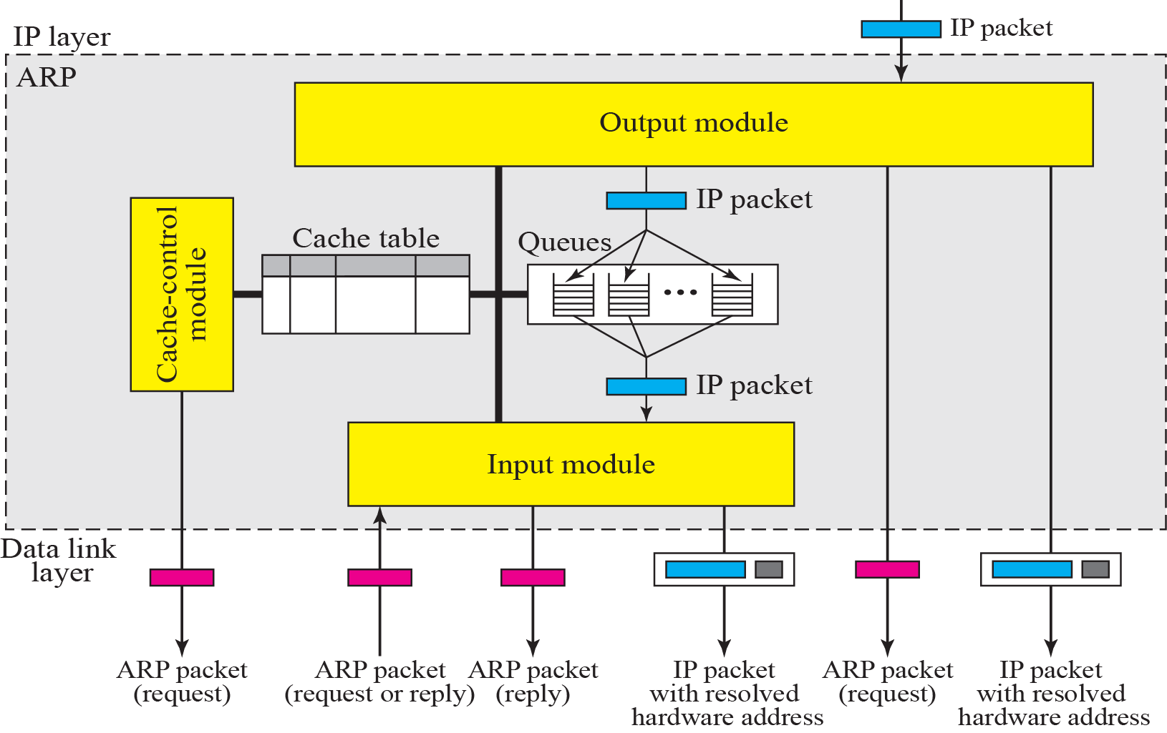
Figure 8.13 ARP components

Slide 37
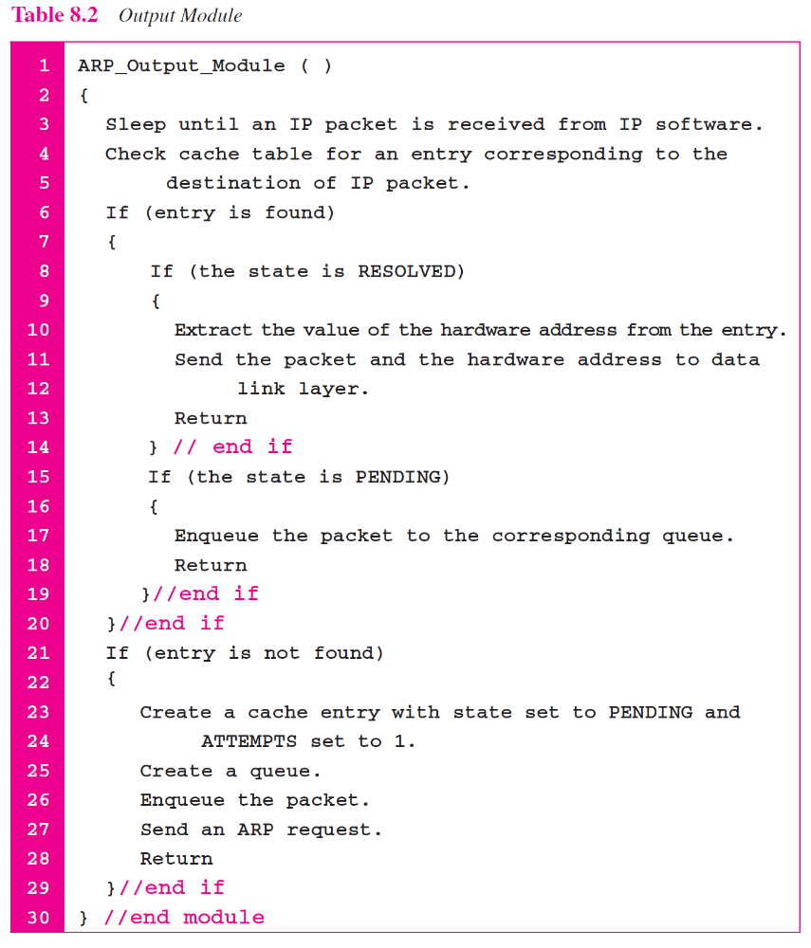

Slide 38
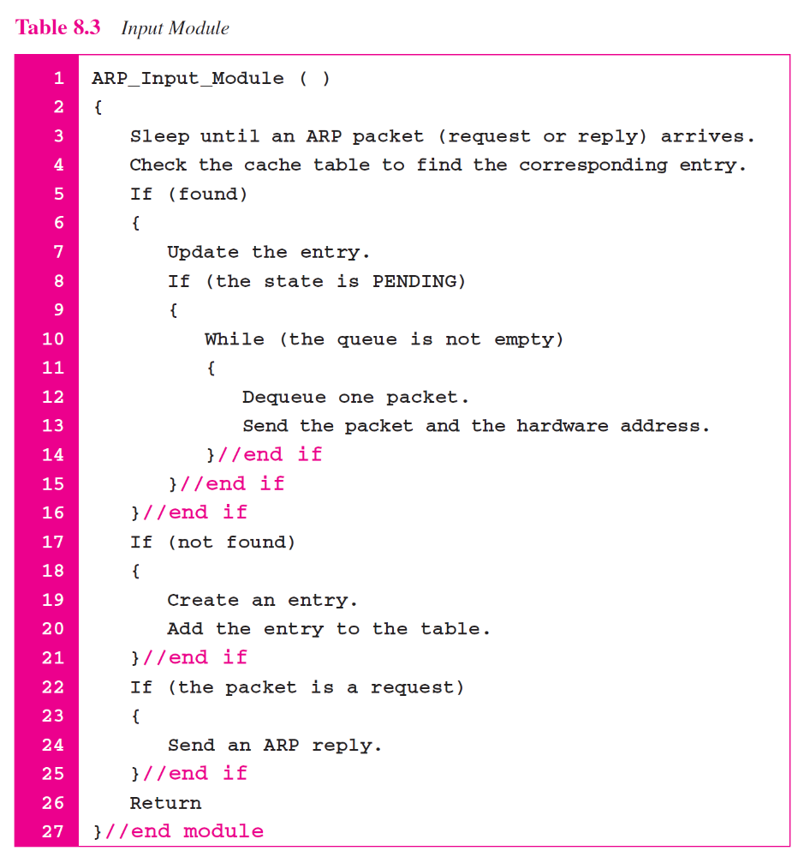

Slide 39
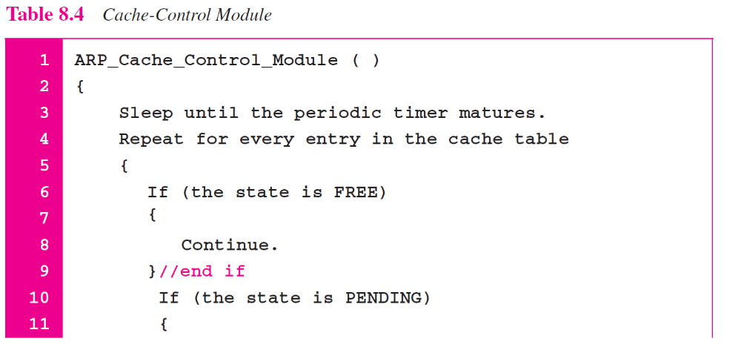

Slide 40
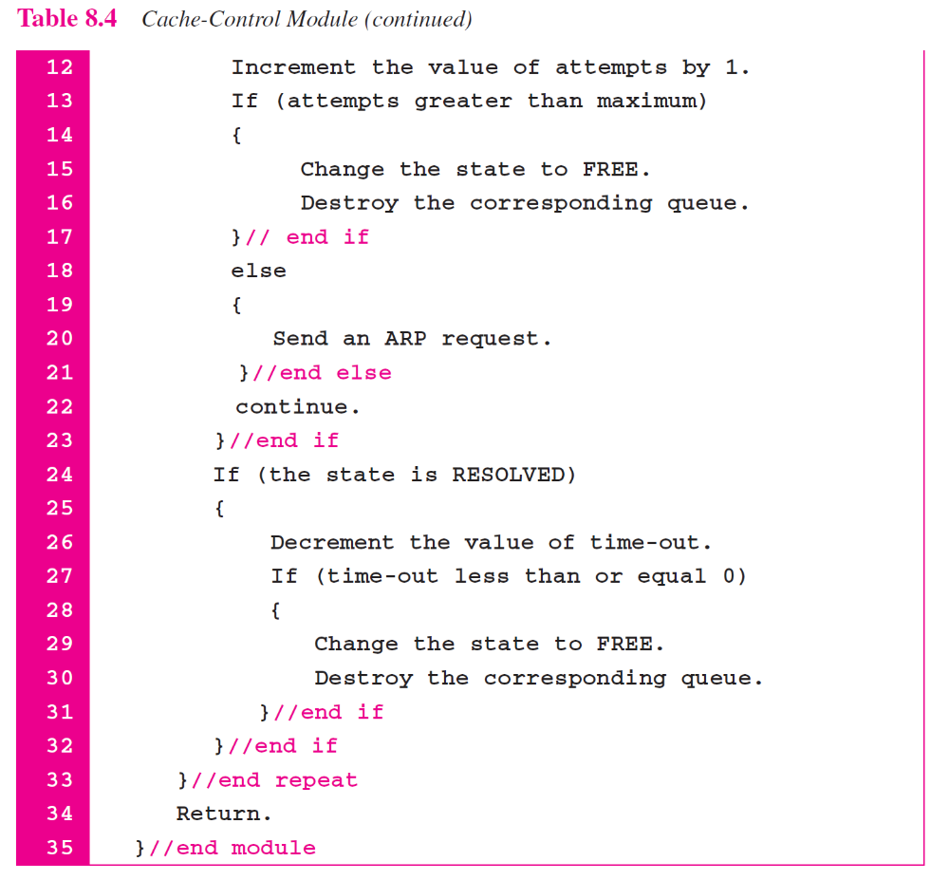

Slide 41
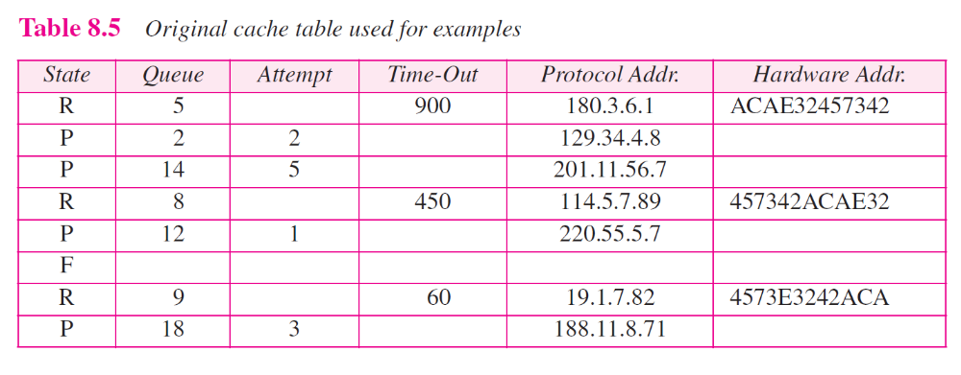

Slide 42
Example 8.2
The ARP output module receives an IP datagram (from the IP layer) with the destination address 114.5.7.89. It checks the cache table and finds that an entry exists for this destination with the RESOLVED state (R in the table). It extracts the hardware address, which is 457342ACAE32, and sends the packet and the address to the data link layer for transmission. The cache table remains the same.

Slide 43
Example 8.3
Twenty seconds later, the ARP output module receives an IP datagram (from the IP layer) with the destination address 116.1.7.22. It checks the cache table and does not find this destination in the table. The module adds an entry to the table with the state PENDING and the Attempt value 1. It creates a new queue for this destination and enqueues the packet. It then sends an ARP request to the data link layer for this destination. The new cache table is shown in Table 8.6.

Slide 44
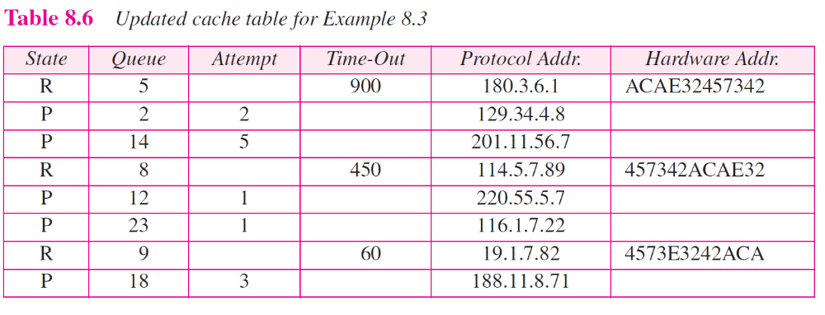

Slide 45
Example 8.4
Fifteen seconds later, the ARP input module receives an ARP packet with target protocol (IP) address 188.11.8.71. The module checks the table and finds this address. It changes the state of the entry to RESOLVED and sets the time-out value to 900. The module then adds the target hardware address (E34573242ACA) to the entry. Now it accesses queue 18 and sends all the packets in this queue, one by one, to the data link layer. The new cache table is shown in Table 8.7.

Slide 46
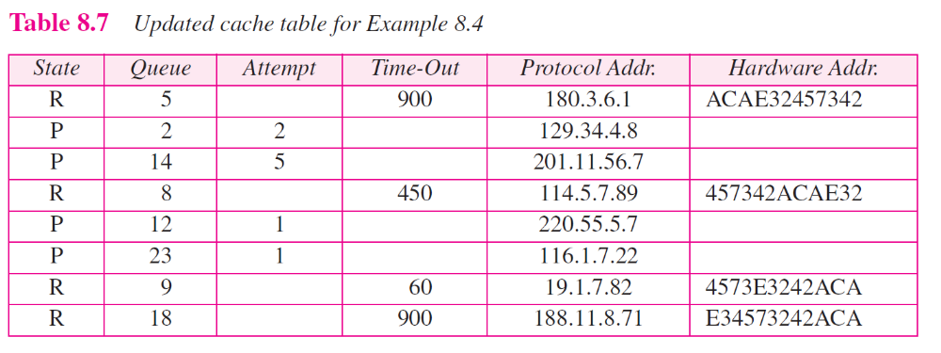

Slide 47
Example 8.5
Twenty-five seconds later, the cache-control module updates every entry. The time-out values for the first three resolved entries are decremented by 60. The time-out value for the last resolved entry is decremented by 25. The state of the next-to-the last entry is changed to FREE because the time-out is zero. For each of the three pending entries, the value of the attempts
field is incremented by one. After incrementing, the attempts value for one entry (the one with IP address 201.11.56.7) is more than the maximum; the state is changed to FREE, the queue is deleted, and an ICMP message is sent to the original destination (see Chapter 9). See Table 8.8.

Slide 48
